Slide 1
Gen-LaneNet: A Generalized and Scalable Approach for 3D Lane Detection ECCV 2020
Yuliang Guo*, Guang Chen, Peitao Zhao, Weide Zhang, Jinghao Miao, Jingao Wang, and Tae Eun Choe
Baidu Apollo, Sunnyvale CA 94089, USA
https://github.com/yuliangguo/Pytorch Generalized 3D Lane Detection

Slide 2
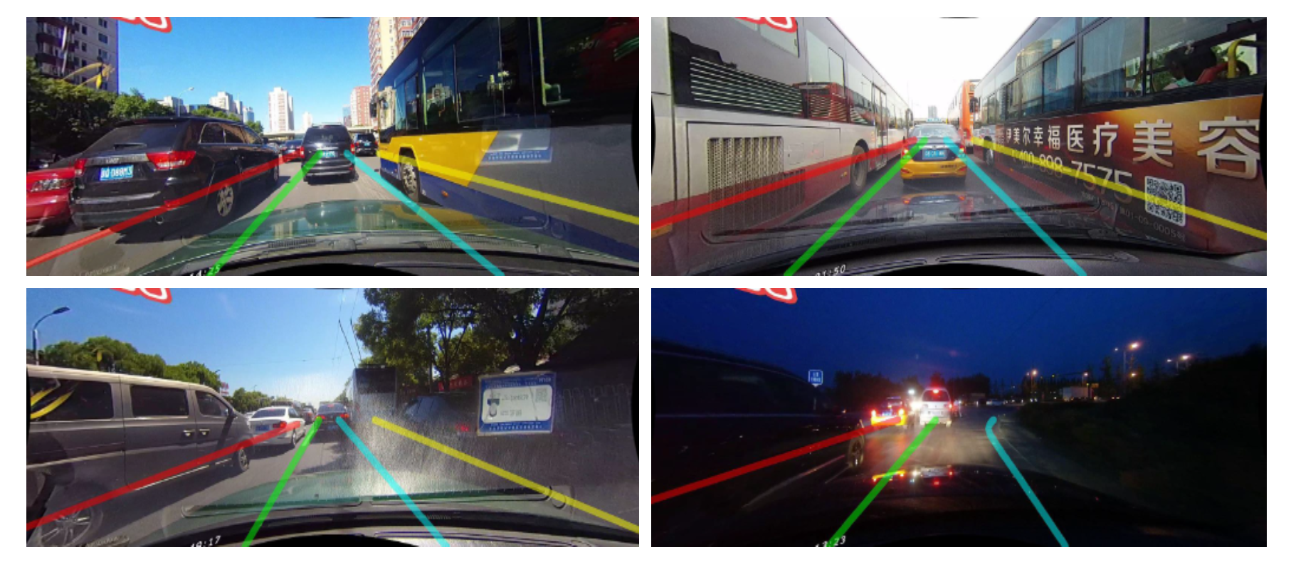
2D lane detection

Slide 3
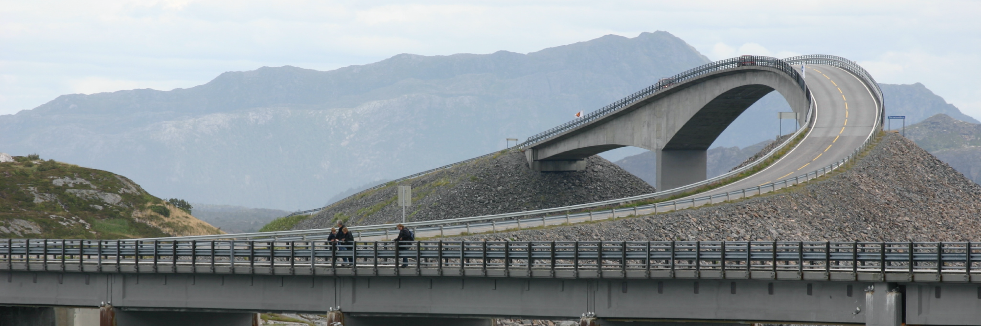
Why do we detect 3D lane?

Slide 4
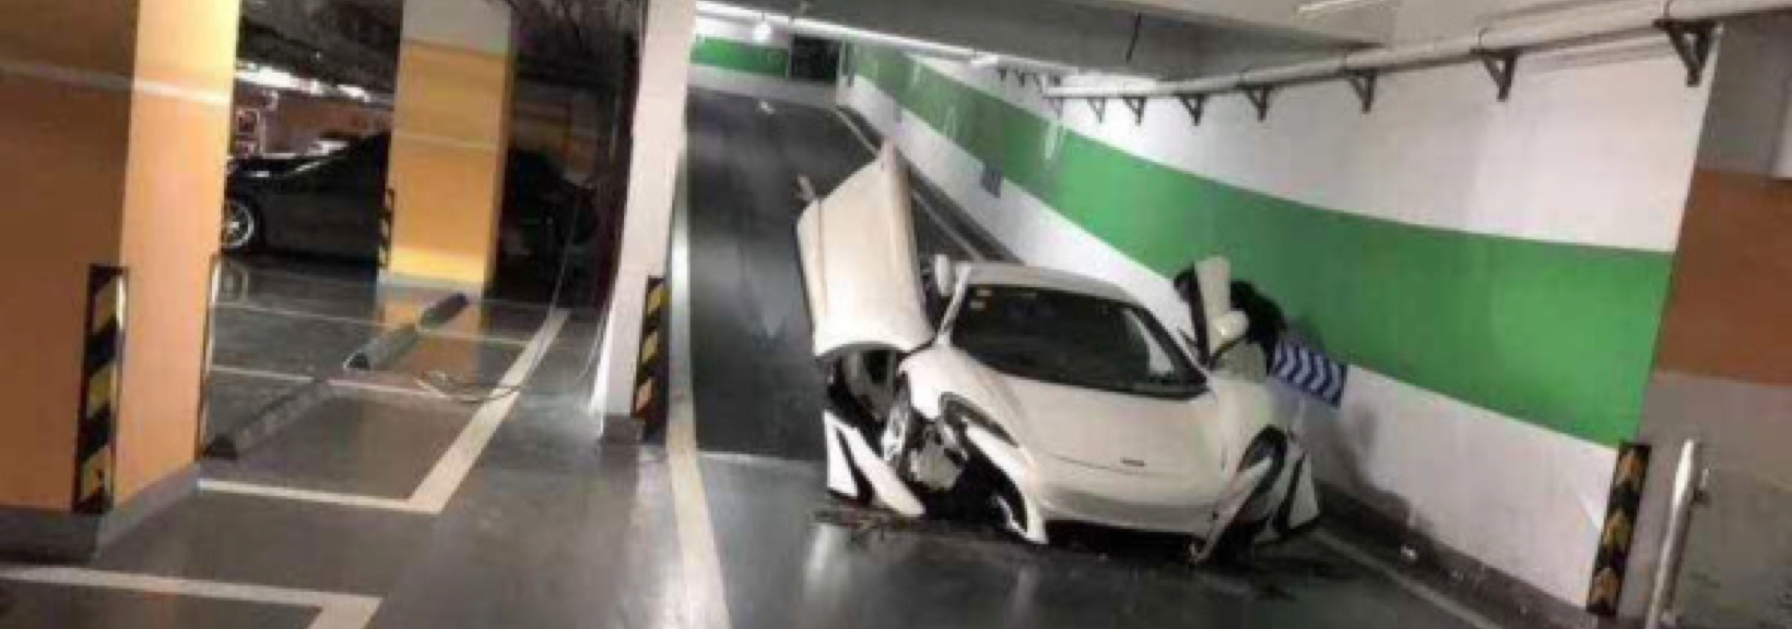
Why do we detect 3D lane?

Slide 5
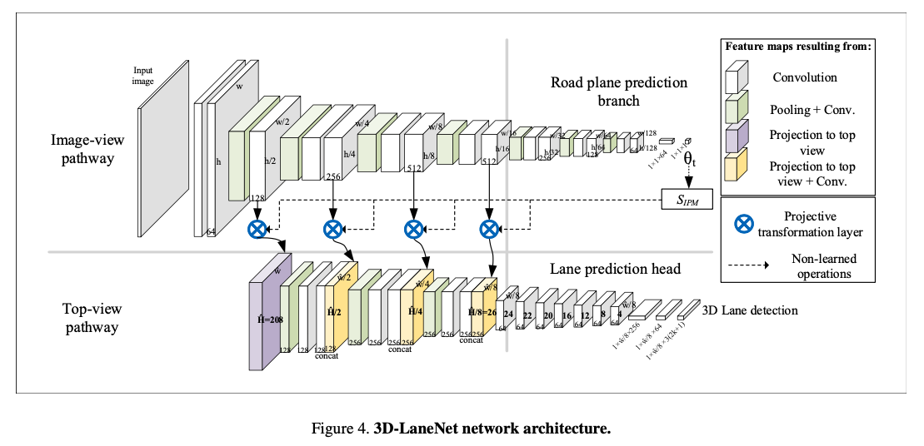
3D-LaneNet

Slide 6
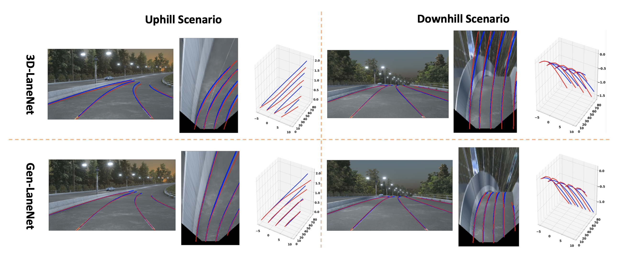
Motivation
3D LaneNet在锚定表示中使用了一个不合适的坐标系，其中地面真实车道与视觉特征不一致。
由于端到端学习网络将三维几何推理与图像编码紧密结合，使得几何编码不可避免地受到图像外观变化的影响。

Slide 7
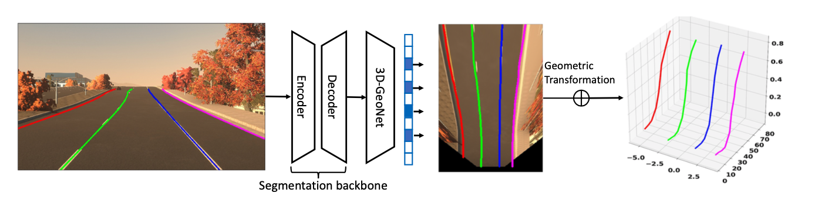
Contributions
引入了一种新的几何导向车道锚定表示，采用特定的几何变换直接从网络输出三维车道点
提出了一个可扩展的两阶段框架，允许图像分割子网和几何编码子网的独立学习
提出了一个具有丰富视觉变化的图像合成数据集

Slide 8
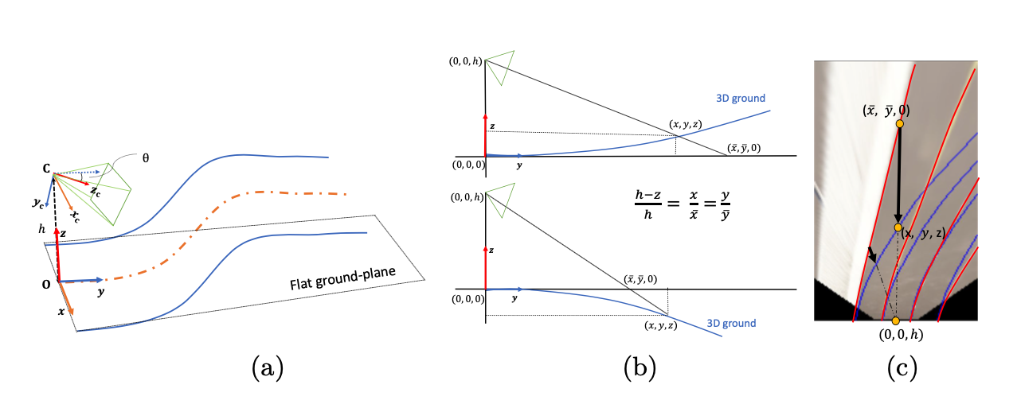
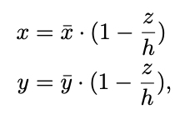
Geometry in 3D lane detection

Slide 9
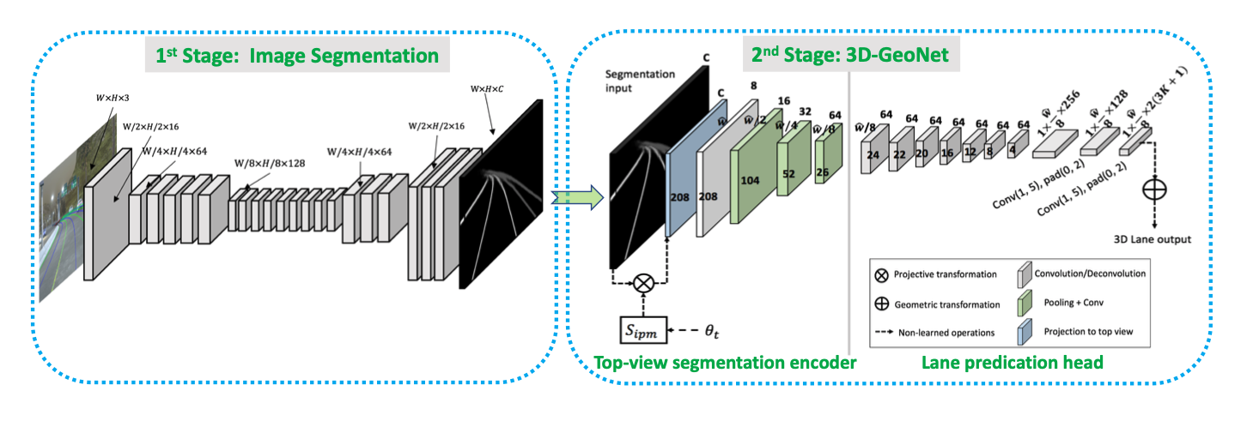
Method

Slide 10
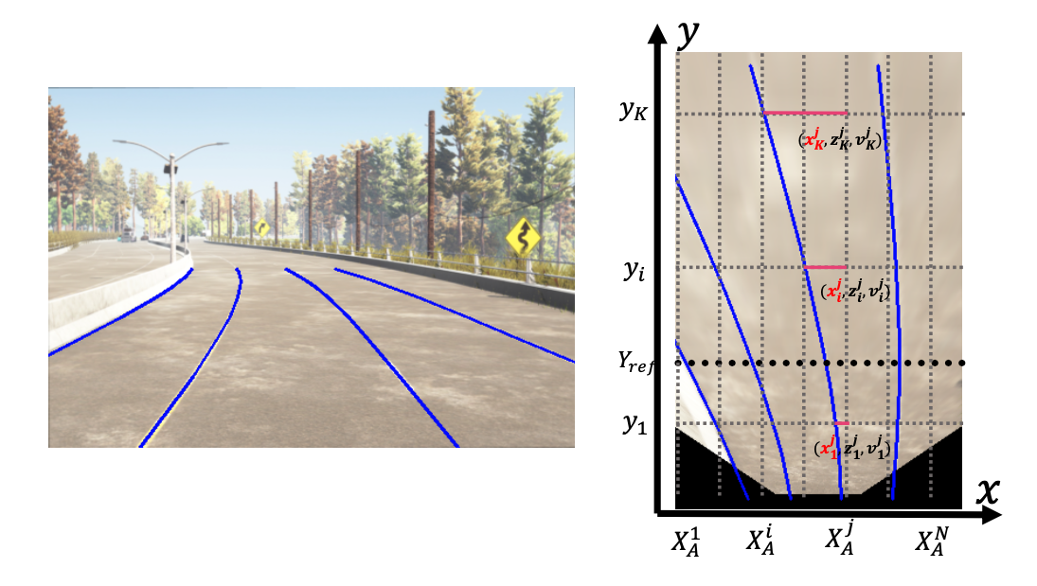
Anchor representation
Prediction layer size: 2N(3K+1)

Slide 11
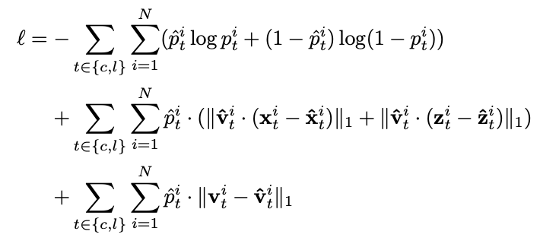
Loss Function

Slide 12
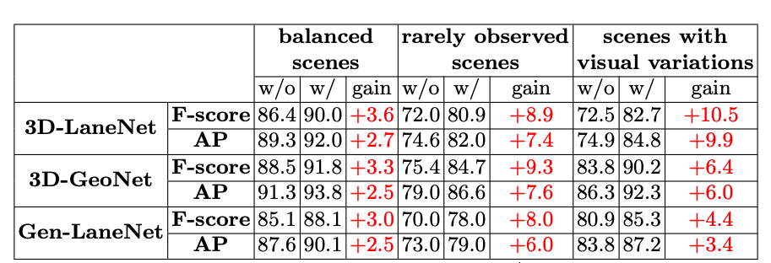
Experiment - Anchor Effect

Slide 13
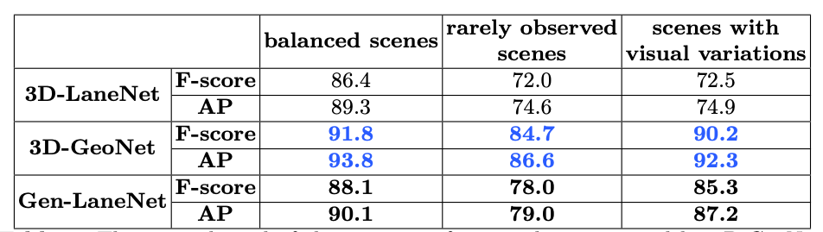
Experiment - The Upper Bound of the Two-Stage Framework

Slide 14
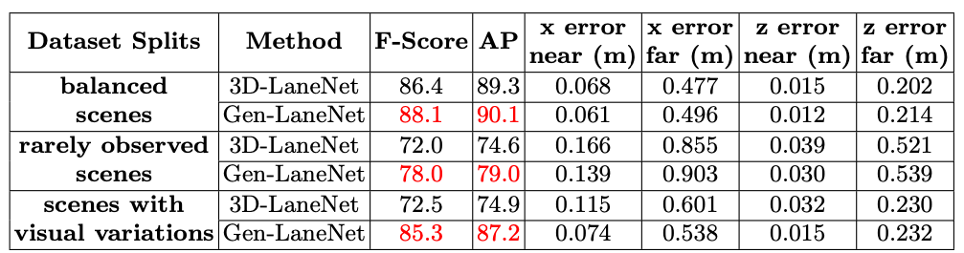
Experiment - Whole System Evaluation

Slide 15
Experiment - Whole System Evaluation

Slide 16
Experiment - Whole System Evaluation

Slide 17
Experiment - Whole System Evaluation

